Slide 1
Building Better Bricks: Module design and development best practices.

Slide 2
Chris Gardner
DevOps and ALM consultant at Black Marble
4+ Years PowerShell experience
Spent the last 2 years+ automating software builds and writing DSC
Contribute to various DSC resources and maintain 1.5 of my own
Usually found on Slack (PSUGUK and PowerShell)
https://www.github.com/ChrisLGardner

Slide 3
Agenda
Why?
Function Design
Module Structure options
Folder Structure
Build Scripts
Testing
Documentation

Slide 4
Why?
We’re developers technologists
Easier for other people to contribute
Easier for people to use
Notes:
https://github.com/PoshCode/PowerShellPracticeAndStyle
A dev in my opinion is anyone who has written and saved a PowerShell script. Copy/Pasting from Google or StackOverflow doesn’t quite count. That doesn’t mean everyone is suddenly a good developer. You can be a developer no matter what your actual job title is.
To be a good developer you need to implement more of the practices that “traditional” developers use, like source control, unit testing, CI, etc. Not all developers do this, I’ve got a number of horror stories about people who claim to be developers not doing some of these things (or all of them in the case of one team) but just because your job title is developer doesn’t mean you’re a good developer. The reverse is also true, just because your title is sysadmin doesn’t mean you aren’t a good developer.

Slide 5
Function Design
Always include an output type for functions which output an object
Always write-output/$var your objects
Always add CmdletBinding to enable advanced functions
Accept pipeline input on Set-*/Update-*/etc functions
Notes:
PSSA will complain if you don’t have an output type, but it also makes the code more readable and understandable for anyone looking at it.
Some people would argue you shouldn’t use Write-Output and instead just use $var. Either works and the balance you have to decide on is the trade off between readability from using Write-Output with the confusion it can cause when people use it for more than just actual output when they should be using Write-Verbose or Write-Information instead.
Always use Approved Verbs, always use sensible singular nouns. Etc
Cmdletbinding or [parameter()] will enable advanced functions but it’s often best to be explicit about this and not everyone is aware of the [parameter()] attribute enabling it.
Get-* and similar can also accept pipeline input when it makes sense.

Slide 6
Function Design
Consider including a PSTypeName for custom objects
Descriptive variable and function names
Common names for parameters, e.g. ComputerName
Notes:
https://stackoverflow.com/a/66693/7612001
https://poshoholic.com/2008/07/05/essential-powershell-define-default-properties-for-custom-objects/
https://poshoholic.com/2008/07/03/essential-powershell-name-your-custom-object-types/
Classes are another option instead of PSTypeName, especially when you’ve got a variety of constructors that let you cast common types into basic versions of your class. They should only be used when you know your module will be running on PSv5+ since earlier versions don’t support them.
You can do some nifty tricks to work around your users not passing in the write pstypename object. See the demo of Get-UserData and Set-UserData
Parameter aliases are a good option when you want to allow users to use ComputerName as well as other things like Server, Target, Endpoint or anything else that makes sense in your environment.

Slide 7
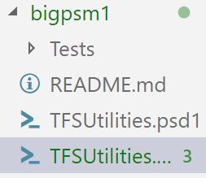
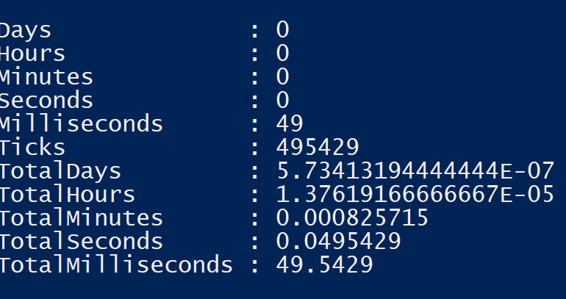
Module Structure – Big psm1
Pros
Quick to load
Easy to distribute
Cons
Difficult to maintain
Can become very long
Notes:
In the example module there are 3700+ lines of code in the psm1. Trying to resolve merge conflicts on that size file gets pretty difficult and just generally reviewing the changes on such a file isn’t easy.
PowerShellGet was original 16k lines in a single file.

Slide 8
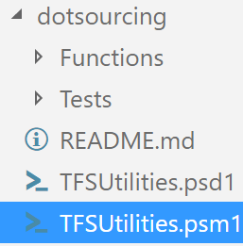
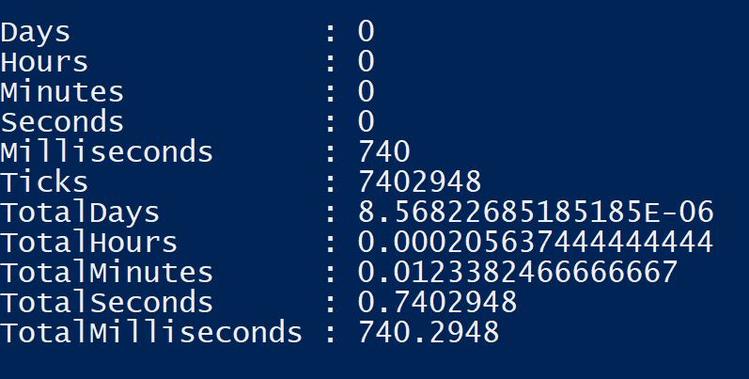
Module Structure – Dot sourced ps1
Pros
Easy to maintain
Short PSM1
Easy to add more functions
Cons
Slow to load
Potential security issues
Slow command discovery
Notes:
When doing code signing you have to sign every single file in the module, the numbers shown here don’t include that but get considerably worse when you have to check the signing on every single file.
PowerShellGet had a dot sourced version after someone refactored the code and the load time was 12s
DbaTools has a dot sourced version for dev users, with it’s 506 public commands, loads in 17s (previously I’d seen it load in 40s on the same machine)
Another option is [Scriptblock]::Create() and [Scriptblock]::Invoke(), its faster than dot sourcing but ignores execution policy and signing so should be avoided.

Slide 9
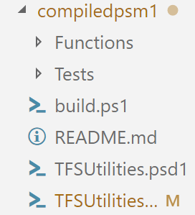
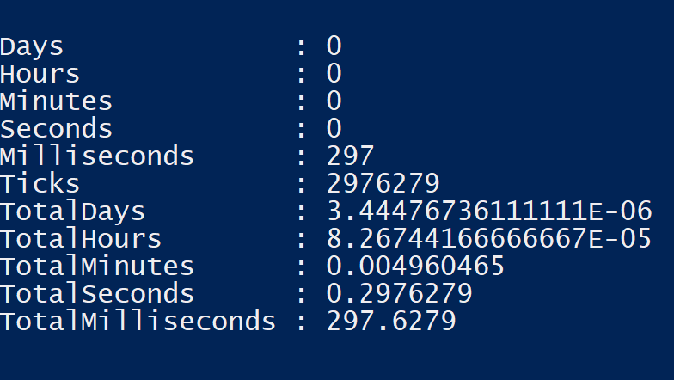
Module Structure – Compiled psm1
Pros
Easy to maintain
Quick to load
Easy to distribute
Easy to add more functions
Cons
Extra learning required to use
Automation needed
Notes:
You should only ship the pd1 and psm1.
PowerShellGet moved to compiling their module again and dropped the load time down to about 2s
DbaTools public version is a compiled psm1 and load time is dropped to about 6s

Slide 10
Module Manifest
Always use one
Name should match folder name in casing
Don’t use * for exported functions, cmdlets, aliases or variables
Notes:
Using a module manifest lets you have greater control of what functions etc from your module are made available to the user and allows you to provide a range of metadata about the module. It’s also required when publishing to a nuget feed like the PowerShell Gallery
As PowerShell is now cross platform it’s necessary for the psd1 file to match the folder name in casing as well as naming. If the module is only going to work on Windows then it’s less necessary but still worth doing.
Constrained Language mode and other restricted language modes won’t load modules that make use of * in the ExportedFunctions and other properties. Be explicit in which ones you’re making available. It also has an impact on command discovery and module import as PS doesn’t then have to fully parse the module to discover what you’re actually exporting.

Slide 11
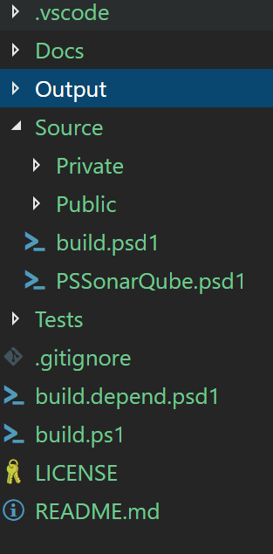
Folder Structure
Git Ignore file set to ignore the output directory
VS Code folder to enforce some coding styles and use build script for debugging
Source split into public and private folders with 1 function per ps1 file.
Templating systems like Plaster and PSModuleDevelopment make this easier to create.
Notes:
Tests can be broken down into unit, integration or other categories. Personally I have a Unit folder for true unit tests and then later will create an Integration folder for integration testing, all using Pester with Tags to differentiate between the types.
Build.depend.ps1 is for PSDepend and handles any dependencies I have for building the module, like Pester, PlatyPS and more. In some other modules I have it download some of those dependencies to the Output folder so that I can ship them with the module for systems that don’t have Internet access.
LICENSE isn’t really necessary for modules that will only be used internally but for public projects please include one, ideally MIT or another very open license.
Other optional files include appveyor.yml or similar task runner files.
Contributing, code of conduct and similar helpful docs for anyone coming along to work on this. These are more needed for open source but a guide to contributing, either in a dedicated file or in the readme, would be very useful regardless of where the module is stored or used.

Slide 12
General Good Practice
Version stamp your module-
Major increases on breaking changes
Minor changes with new non-breaking changes, bug fixes etc
Revision however many times the module was built before releasing this version
Don’t create functions with the same name as core functions.
Create an alias pointing at your suitably named version

Slide 13
Build Scripts
Invoke-Build and PSake for pure PS build automation
Azure Pipelines, AppVeyor, Gitlab etc
Three key steps needed:
Build psm1 from all your ps1 files
Test your built psm1
ScriptAnalyser your psm1
Notes:
The crucial thing here is that you should be testing/PSSA’ing the compiled PSM1. If you don’t then you’re not testing the same thing that you’re shipping.
Automating all of this with InvokeBuild or PSake is a great step too, we’re writing PowerShell to automate the boring things, why wouldn’t we then use PowerShell to automate the building of that automation.
Platforms like Azure Pipelines etc are usually free or cheap (depending on users and where your code sits), they make it much easier to implement this sort of build automation and store your code. The larger tools like Azure Pipelines and Gitlab come with even more tools, Azure Pipelines in particular also comes with work item management that can be leveraged to let you track the next few features you want to add in your code, or any bugs that have been found. Both platforms give you a range of tracability options too, you can get pretty build output to see how your tests ran and fail builds if the tests fail.

Slide 14
Testing
Pester is your friend
Test against the compiled psm1
If a bug is found, write a test for it and then fix it
Notes:
There are a lot of videos and blog posts on writing tests, plus the Pester Book on LeanPub. Glenn Sarti and Brian Bunke have great sessions from PSH Summit talking about writing pester tests. Jakob Jares has some interesting talks from PSConfEU about pester internals and common mistakes in writing tests.
Write tests for how the function should work, expected input and expected output, not for how it currently works (though those sort of tests are pretty useful when refactoring).
You’ll never write perfect code so there will be bugs, when a bug is found you should write a test for it to make sure you can replicate it (maybe more than 1 test) and then fix the code so the test passes. This way you can be more sure that the bug won’t reappear because your test will hopefully fail if it does reappear.

Slide 15
Documentation
Write it
Consider PlatyPS to generate external help
Teach/Remind users about Get-Help
About pages are your friend for complex details
Notes:
Michael T Lombardi has a great talk from PSH Summit about the various types of documentation.
Don’t try writing MAML yourself, it’s awful and PlatyPS makes everything easier for that and CBH.
You can test your documentation (and should), Vors has a good demo on github for how to do that, https://github.com/vors/docs-pedantic-ci-demo, DSC Resources repos has a bunch of tests for their docs too, checking things like line length and endings etc.

Slide 16
Questions?

Slide 17


Chris Gardner
@halbaradkenafin
Chrislgardner.github.io
github.com/chrislgardner
Contact Details

